Slide 1
Time Table Generator
M.Sai Kiran Kumar-2451-16-737-046
D.Sai Pranav -2451-16-737-054
G.Vamshi Krishna-2451-16-737-060
Guide:A.Manasa
Assistant Professor

Slide 2
Abstract
This Web-Application is used to decrease the time taken to generate timetable for any institution,workplaces etc.
In this project, we reduce the human effort in designing the timetable.
By our project we can reduce the flaws that are caused due to human. We have reduced time-complexity to O(N).

Slide 3
Statement of problem
As in the competitive world time is most valuable thing there is a quote that ”we can’t recycle the wasted time”.
In this world we can’t recycle our valuable time once it is wasted so we worked a lot to decrease the time consumption and easy to generate the timetable.
We are designing a application which will decrease the time consumption and decreases the problems faced by any instructions in generating a time table.
Through our Application we can reduce the time taken to solve the errors occurred during preparation of time table manually.

Slide 4
Scope Of Work
This application will decrease the time taken to generate timetable for any institution,workplaces.
This application reduces the human effort in designing timetable.
It will reduce the flaws that are caused due to human.

Slide 5
Software Requirements
HTML
CSS
JAVA(NETBEANS IDE),
JAVASCRIPT
PHP

Slide 6
Hardware Requirements
Processor Speed(i.e Pentium 4, 3.2 GHz or Power PC G5, 2.0 GHz)
Memory: RAM (i.e. 512 MB)
Hard Disk Space (i.e. 316MB)

Slide 7

start
Flow chart:
home
about
login
contact
mainpage
register
Main
page
output

Slide 8
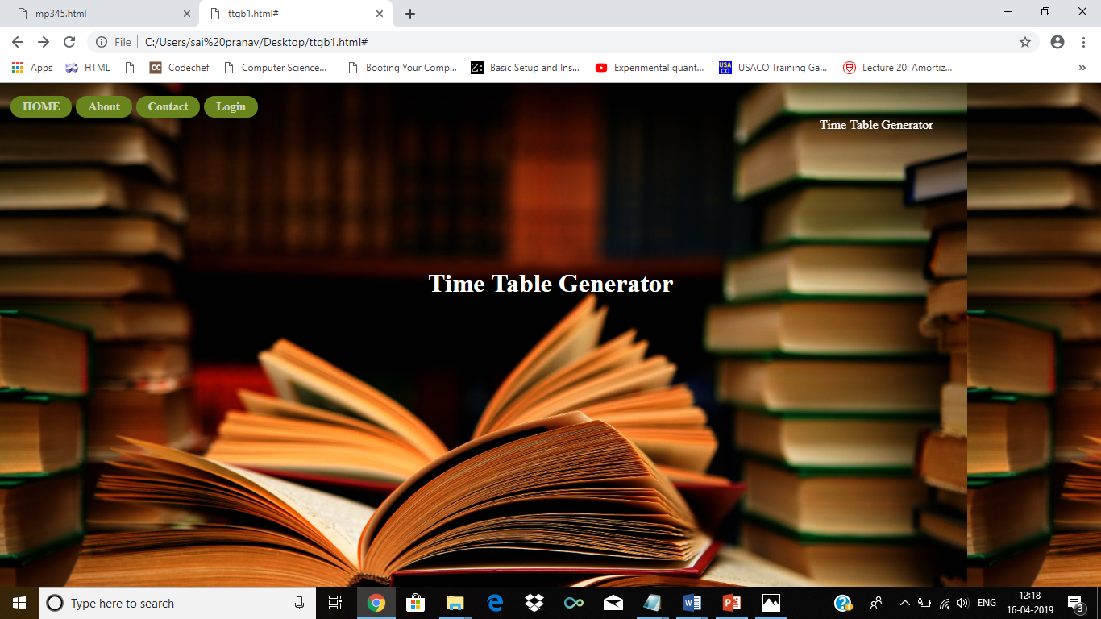
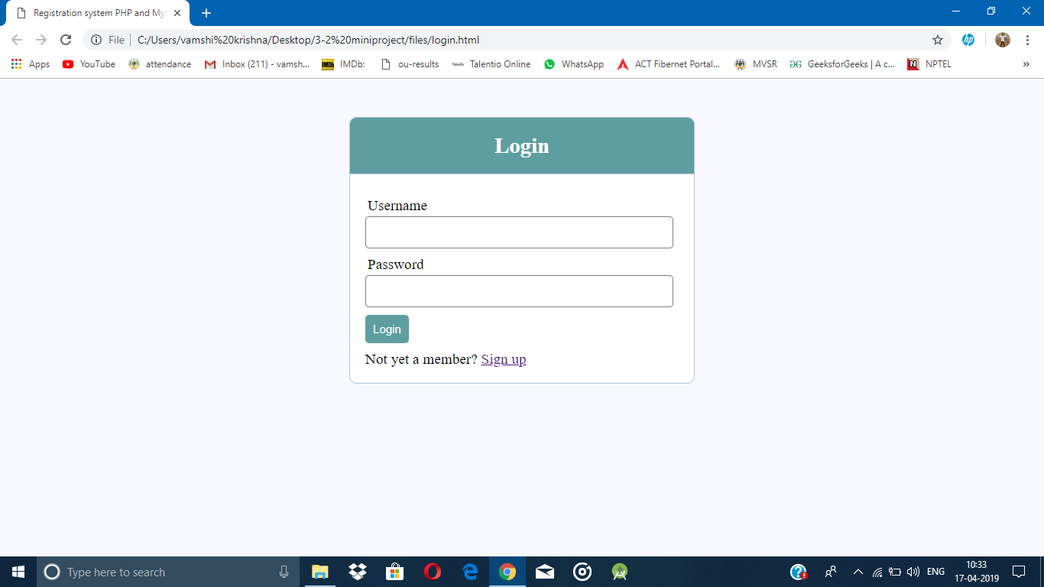
---→ Home page
Login page ←---

Slide 9
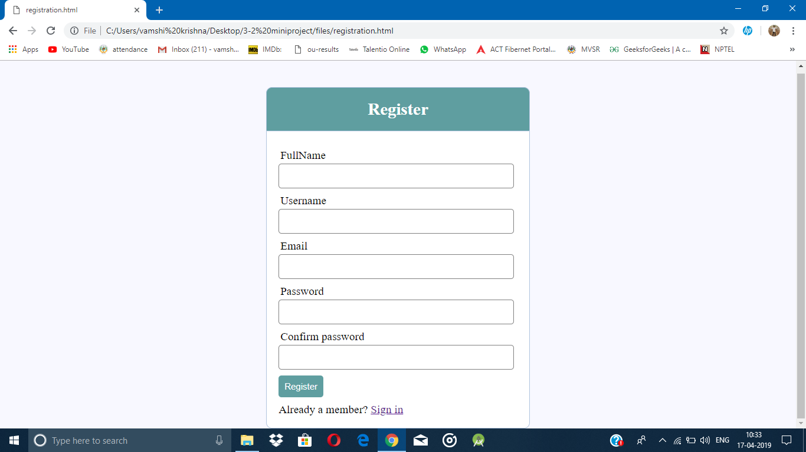
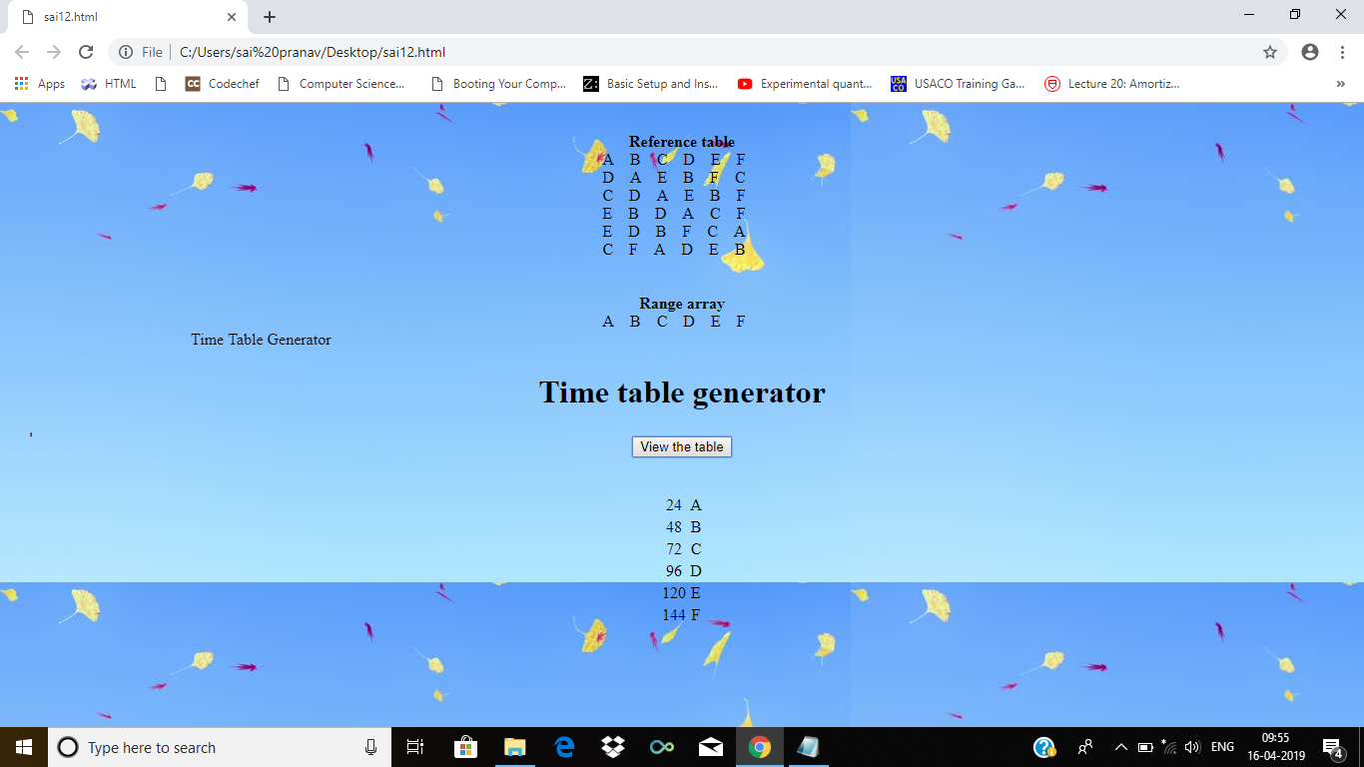
----> Register page
main page---→

Slide 10
Reference table generation
X={24,48,72,96,120,144}
F={24,12,6,3,4,2}
H(x)=x/f | 1 | 2 | 3 | 4 | 5 | 6
X/24 | 24 | 48 | 72 | 96 | 120 | 144
X/12 | 96 | 24 | 120 | 48 | 144 | 72
X/8 | 72 | 96 | 24 | 120 | 144 | 48
X/6 | 120 | 48 | 96 | 24 | 72 | 144
x/4 | 120 | 96 | 48 | 144 | 72 | 24
x/3 | 72 | 144 | 24 | 96 | 120 | 48

Slide 11
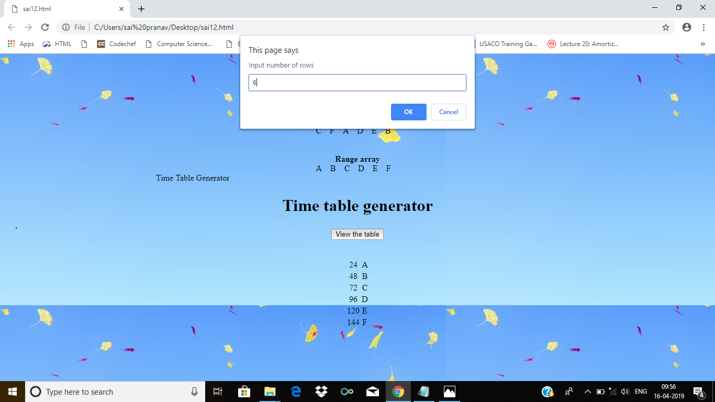
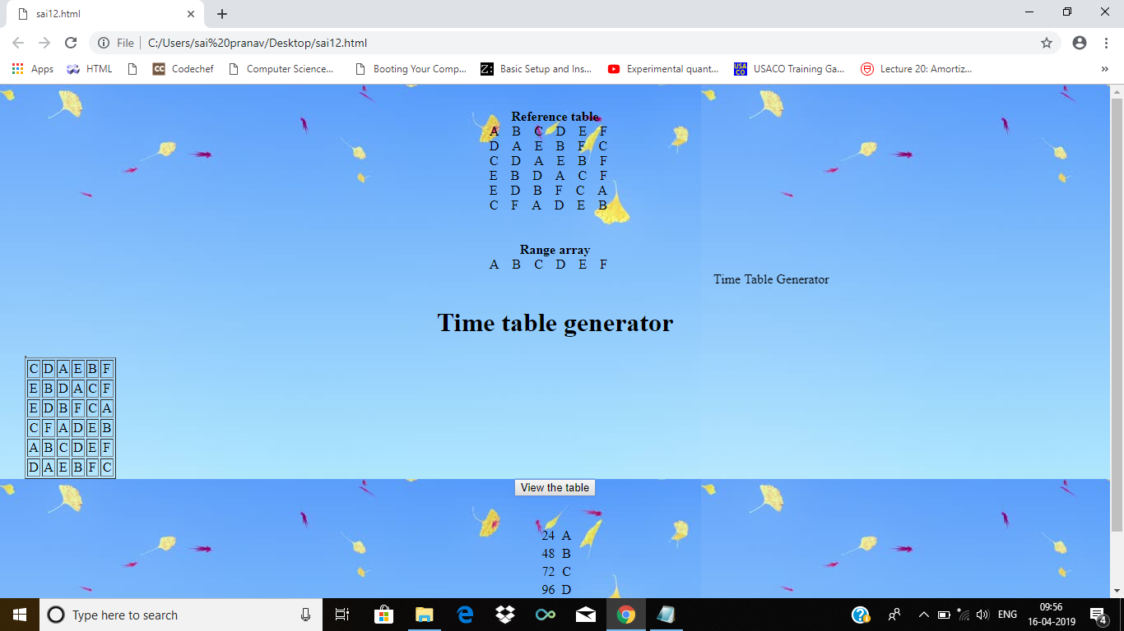
input←-----
Output---→

Slide 12
Advantages
The website will decrease the time taken to generate time table for any institutions ,work places etc.
This website reduces the human effort in designing the time table.
It will reduce the flaws that are caused due to human.
Through our project we are developing a mobile friendly web portal such that institution can generate the timetables.

Slide 13
Disadvantages
The memory of the table increases as the number of sections of the institution increases.Due to this the time limit exceeded error occurs or the code goes into infinite loop.
The project is only possible to allocate only 6 teachers to every distinct slot.
Six sections can only be allocated with this time table generator.

Slide 14
Future Enhancements
Developing this website into an application which will be accessible to all.
To add additional security features for login of user’s in order to restrict the retrival of data by third-parties.
Trying to reduce the Time complexity of the problem.

Slide 15
Conclusion
To solve any real world problem we need to make use of algorithms.A small algorithm we quoted by ourself helped us to generate timetable for bunch of sections.
To reduce the time and space complexity we need to make use of better algorithms.As we have reduced an factorial time solution to linear time growth rate.

Slide 16
ANY QUERIES ???

Slide 17
Thank you

